Slide 1
Unit-1 Part-4
Proof Strategy and Errors in Proofs

Slide 2
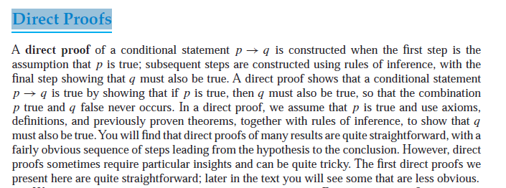


Slide 4
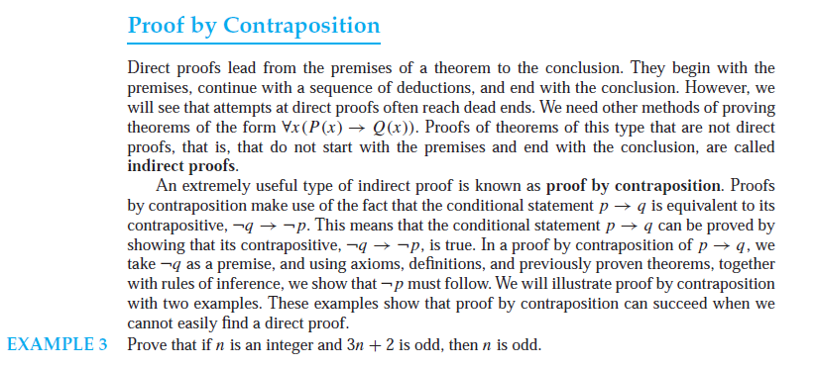

Slide 6
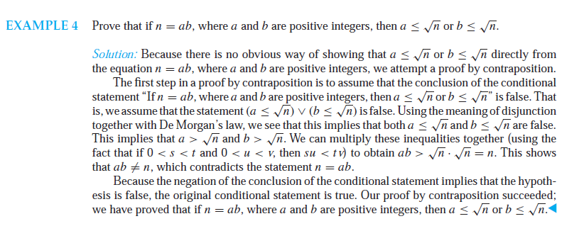

Slide 7
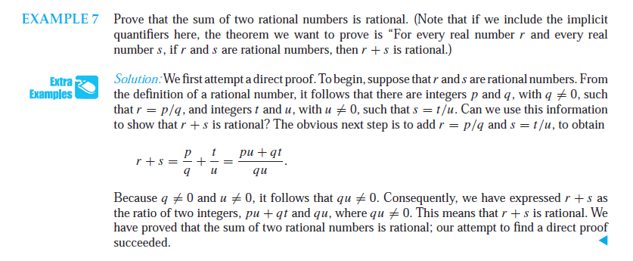

Slide 9


Slide 10
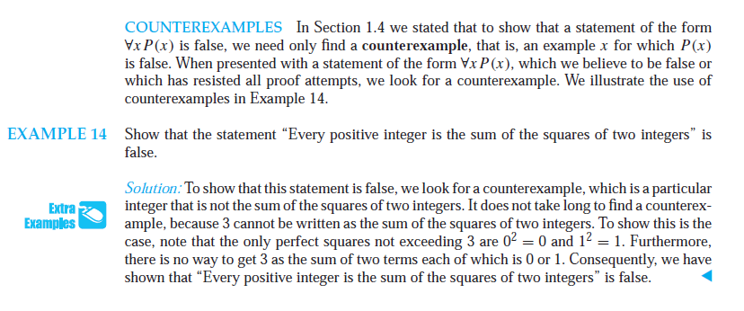

Slide 11


Slide 12


Slide 13
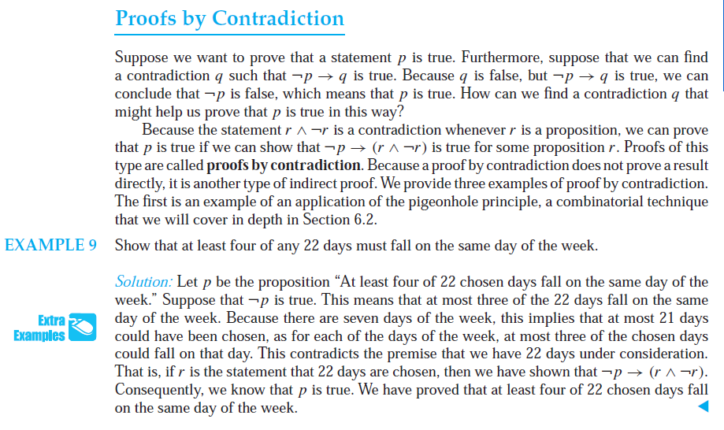


Slide 14
Proofs by Contradiction

Slide 15
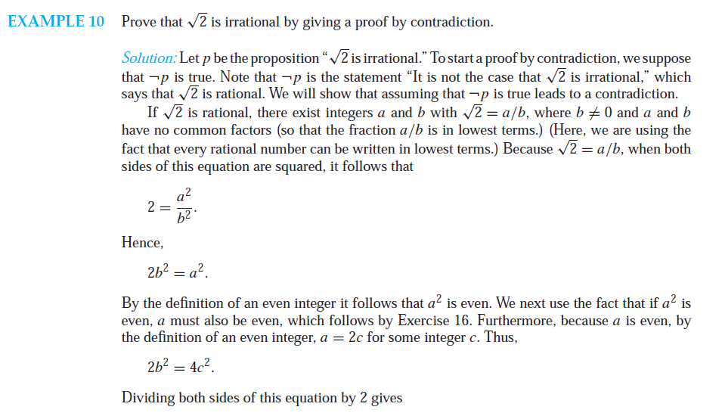


Slide 16


Slide 17
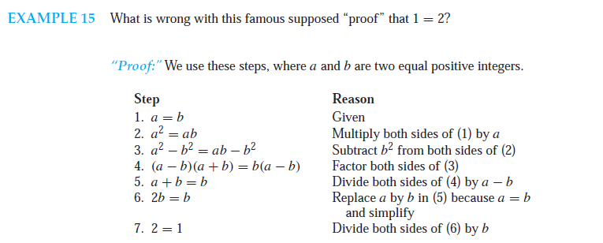
Mistakes in Proofs

Slide 18




Slide 19
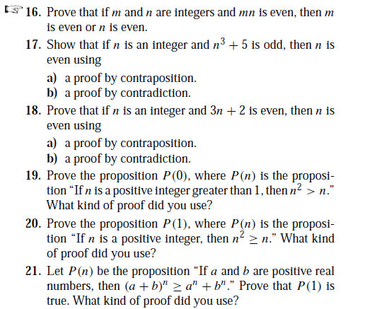

Slide 20
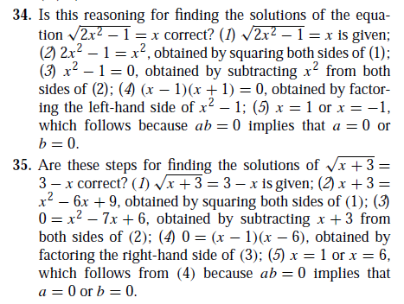

Slide 21
